Slide 1
Α-γενης v. B-γενους προληψης καρκινου τραχηλου μητρας
Ιωαννινα, 16 Νοεμβριου 2019
Professor Evangelos Paraskevaidis
Ioannina Medical School
Greece
President of the
Hellenic Society for Colposcopy & Cervical Pathology (HSCCP)
Hellenic Cervical Pathology Academic (studies) Group (HeCPA Group)

Slide 2
Disclosures
  No financial relationships or conflict of interest to disclose

Slide 3
EFFICASY OF PREVENTION
Secondary/cervical cyto screening
Primary/ HPV vaccination
SIMILAR PROTECTION : ~ 70%

Slide 4


Vaccination v. Screening
Effectiveness…similar : ~ 70 %
Bilateral losses….
Prevention of Precancer:
Complications after CIN Tx…
Reproductive Morbidity…
Failure rates (Cx Ca)…
Psychological morbidity…
Health Systems:
Infrastructure …
Cost…
Benefits outside the cervix:
Prevention of other cancers…
Genital warts…
Notes:
And finally [screening is so effective]
these lesions can be treated with high efficacy using simple outpatient procedures if they are detected early.

Slide 5

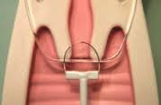


§
Gestation (Weeks)
12
24
28
32
37
2006 Kyrgiou
Overall prematurity
2008 Arbyn
Severe & extreme PD
Perinatal mortality
2014 Kyrgiou BMJ
2nd trimester miscarriages=early pregnancy losses

Slide 6
Classic Papers : Articles That Have Stood The Test of Time
….articles that continue to have high impact
far long after their publication…
Google Scholar Blog
2019

Slide 7

Adverse obstetric outcomes after local treatment for cervical preinvasive and early invasive disease according to cone depth: systematic review and meta-analysis
Maria Kyrgiou, Antonios Athanasiou, Maria Paraskevaidi, Anita Mitra, Ilkka Kalliala, Pierre Martin-Hirsch, Marc Arbyn, Phillip Bennett, Evangelos Paraskevaidis
BMJ August 2016

Slide 8
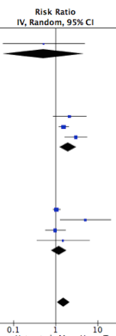
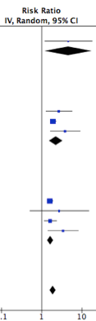
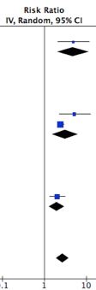
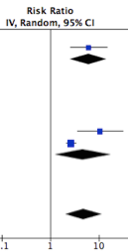
JAMA Oncol 2016 BMJ 2016
<10/12mm
>10/12mm
>15/17mm
>20mm
1.54 RR
1.93 RR
2.77 RR
4.91 RR

Slide 9
Lancet 1997
Invasive cervical cancer after conservative therapy for cervical intraepithelial neoplasia
Soutter WP, de Barros Lopes A, Fletcher A, Monaghan JM, Duncan ID,
Paraskevaidis E, Kitchener HC
44 699 woman-years FU, 2116 women, 8 yrs post tx
Tx reduces the risk of invasive cancer by 95%
However, it still remains:
5 times greater than that among the general population

Slide 10
Invasive cervical cancer after conservative treatment of CIN
REVIEW of the LITERATURE
Single Center CASES Report
the HeCPa study group
EUROGIN : AMSTERDAM, OCTOBER 2017
EUROGIN : LISBON, DECEMBER 2018
EUROGIN : MONACO, DECEMBER 2019
Notes:
ατ ΠΡ, αγ ΣΝ, ΚΣ σ
Θρ υπχρ να ευχ τη Ο.Ε τ. σνδ που μας ανθσ ν παρ τα συγκ θμ κ ταυτ να ειμαστε σε ένα τραπεζι με καθ. 1^{ης} βαθμ.

Slide 11
All studies show increased risk…
Annals of Oncology, in press
Study | Relative Risk | Proposed follow-up (years) | Notes
Soutter, (1997) | 5 | 10+ | 44,699 woman-years of follow-up: 85/100000woman years
Kalliala, (2005) | 2.8 | 20+ | Anogenital cancers also
Strander, (2007/2014) | 4.5 | 25+ | Increased incidence with age (treatment / follow-up)
Melnikow, (2009) | 6.2 |  | Increased >50years
Rebojl, (2012) | 6.1 |  | increased for all ages
Notes:
HIGH IMPACT STUDIES
Reference on other ano-genital cancers as well?

Slide 12
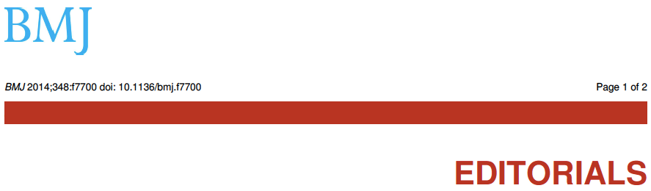
Long term outcomes for women treated for cervical precancer
M Arbyn , M Kyrgiou , J Gondry , K U Petry , E Paraskevaidis
2016
… state of Art to achieve life time :
risk of cancer & obstetric morbidity…
equal to gen population
‘ Obstetrical & Oncological Outcomes of Tx ’
BSCCP , 2 May 2018 ,MAnchester

Slide 13
Benefits of Vaccination over Screening
Effectiveness…
Prevention of Precancer:
Complications after CIN Tx…
Reproductive Morbidity…
Failure rates (Cx Ca)…
Psychological morbidity…
Health Systems:
Infrastructure …
Cost…
Benefits outside the cervix:
Prevention of other cancers…
Genital warts…
Notes:
And finally [screening is so effective]
these lesions can be treated with high efficacy using simple outpatient procedures if they are detected early.

Slide 14
Greece : Vaccination status against HPV in Hellenic Population -2016
Cumulative HPV Vaccination coverage –girls 11-26 y (2007-2016)
Why ;
The majority of girls remain un- vaccinated despite Full reimbursement from the National Health System
IMS data, 2016

Slide 15
1.ΕΜΒΟΛΙΟ HPV : ΕΞΑΛΕΙΨΕ ΤΟΝ ΚΙΝΔΥΝΟ ΓΙΑ ΚΑΡΚΙΝΟ ?
2.ΕΜΒΟΛΙΟ HPV : ΕΞΑΛΕΙΦΘΗΚΕ Ο ΦΟΒΟΣ ΓΙΑ ΤΙΣ ΠΑΡΕΝΕΡΓΕΙΕΣ ΤΟΥ ?
ΙΣΟΡΡΟΠΙΑ ΦΟΒΟΥ :
ΚΑΡΚΙΝΟΥ ν. ΕΜΒΟΛΙΟΥ
?
?

Slide 16
HPV Vaccination Coverage in Greece
Ignorance only in Greece ?
France ?
Germany ?
Italy ?
Spain ?
Portugal ?

Slide 17


Slide 18

Παθολογία τραχήλου σε HPV εμβολιασθείσες γυναίκες στην Ελλάδα
Νικόλαος Τσάγκας
(ειδικευόμενος Μ/Γ Π.Γ.Ν.ΙΩΑΝΝΙΝΩΝ)
Μαρία-Ευγενία Αναφορίδου, Μαρία Κύργιου, Γεώργιος Βαλασούλης, Νίκος Ράφτης, Μαρία Παρασκευαίδη, Αντώνιος Αθανασίου, Ευριπίδης Μπιλιράκης, Μαρία Νασιουτζίκη, Αλέξανδρος Δαπόντε, Αναστασία Βατοπούλου, Αλέξιος Παπανικολάου, Γεώργιος Μιχαήλ, Ευθύμιος Δεληγεώρογλου, Αριστοτέλης Λουφόπουλος, Πέτρος Καρακίτσος, Ευάγγελος Παρασκευαίδης & the HeCPA Study Group

Slide 19
Απόφαση για θεραπεία / ιστολογία
Παθολογία τραχήλου σε HPV εμβολιασθείσες γυναίκες (προ sex)
Ιωάννινα , n = 849
6% LLETZ
8,3% LLETZ
1 LLETZ

Slide 20
Prevalence of cervical disease at age 20 after immunisation with bivalent HPV vaccine at age 12-13, in Scotland
BMJ April 2019
Conclusions
-- HPV vaccine in Scotland has led to a :
dramatic reduction in preinvasive cervical disease
-- Commom sence dictates that it should also :
greatly reduce the incidence of cervical cancer

Slide 21
HPV vaccination post treatment of HPV-related lesions in Greece: a HeCPA study
A. Ioannina,Alex/lis,Thes/niki,Larisa,Patra,Athens,Crete
Prospective , observatinal , multicentric design
B. UK , GREECE , FINLAND , BELGIUM , SWITZERLAND
Prospective RCT,multicentric,multinational design
[ VIENNA, 3-4 May 2018, MSD ]
Eur J Gyn Oncol , August 2019

Slide 22
Cancer reduction (%) with vaccination and/or screening
Screening
only
Vaccine
only
Vaccine and
Screening
Screening: Cytology with HPV for ASCUS 25-35 y, HPV test with reflex cytology thereafter
Goldhaber-Feibert et al JNCI 2008

Slide 23
Life Style - Cervical Pathology Risk
LS-CPR - BSCCP Apr 2016
- 2019, ‘in press’
-smoking No socially >20cg
-menarche/onset sex >10 >5 <3
-sexual partners <5 5-10 >10
condom use 100% 50% 0%
-vaccine(bs,as,no) prior sex After sex No
-post-tx:grade,margins free involved inv+G3

Slide 25

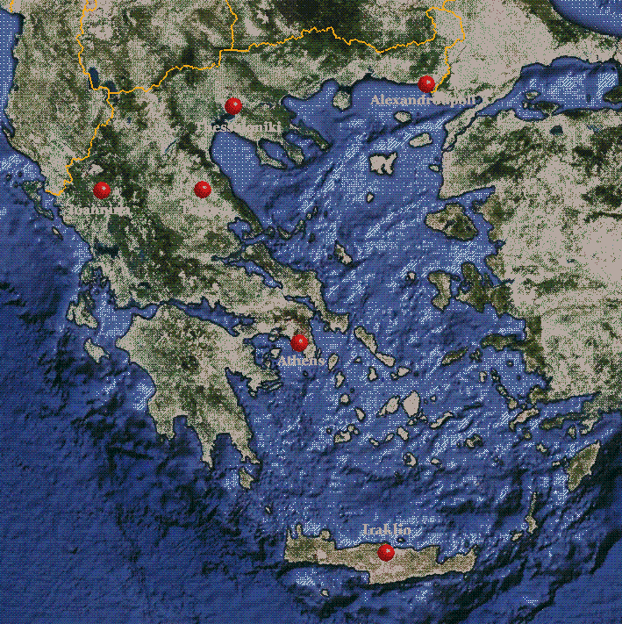
Hellenic Cervical Pathology Academic Group
(HeCPA Group)
Design | Prospective, pragmatic, diagnostic series of studies, ongoing
Setting | Academic Depts. OB-GYN, Greece Coordinating center: Ioannina
Population | Women referred with LSIL
Period | 10/2008-ongoing
Intervention | HPV typing, NASBA, flow cytometry, APTIMA , p16
Outcomes | S, SP, PPV, NPV for each marker and combinations
End point | CIN2+

Slide 26
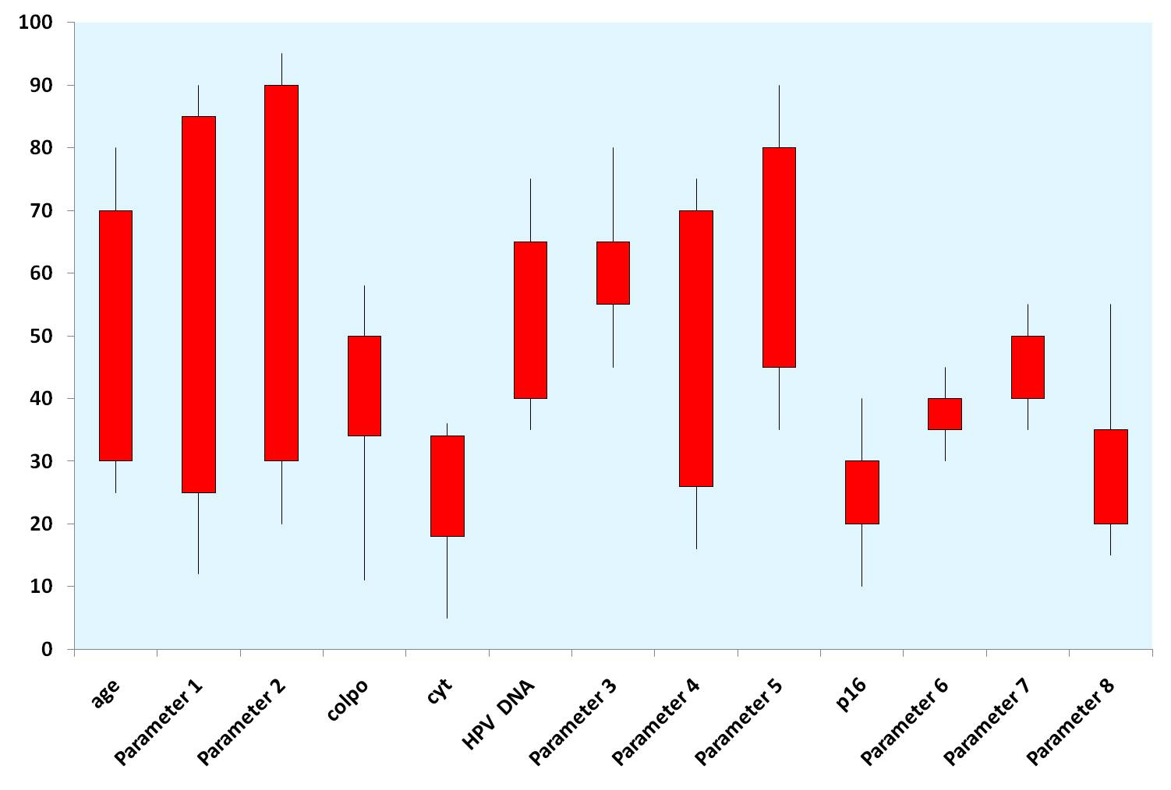
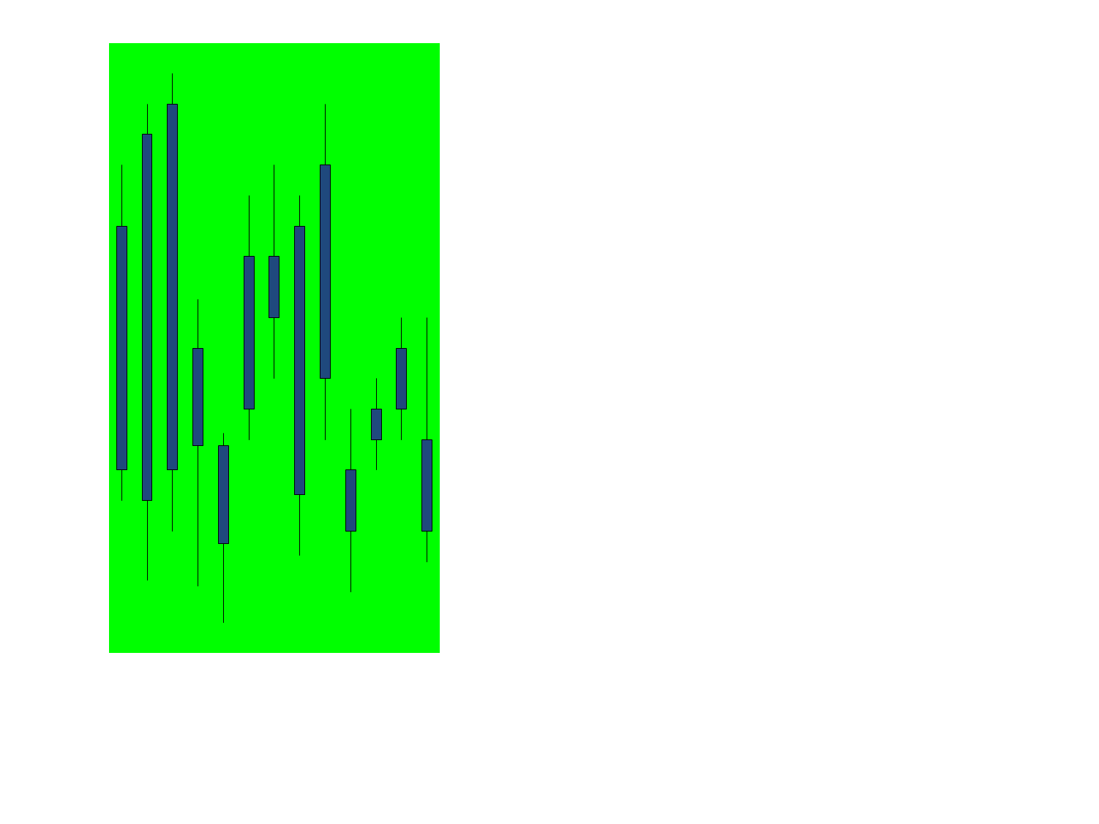


Scoring System
Starting Line:
Cytology OR
HPV DNA test
Patient characteristics
Colposcopy
Best combination of biomarkers…
+
Regression
Persistence
Progression

Slide 27
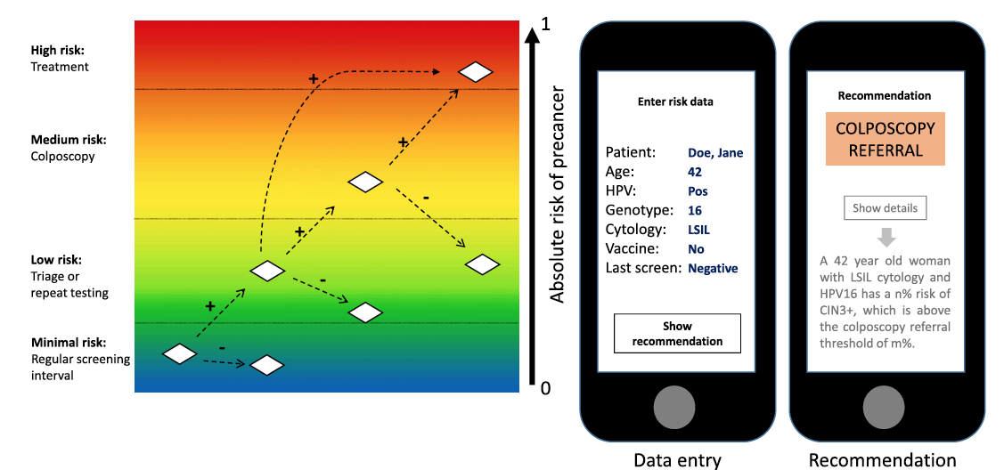
Preparing for the Next Round of ASCCP-Sponsored
Cervical Screening & Management Guidelines
Αmerican Society Colposcopy & Cervical Pathology, JLGTD April 2017

Slide 28
Ioannina, Greece
Thank you

